Slide 1

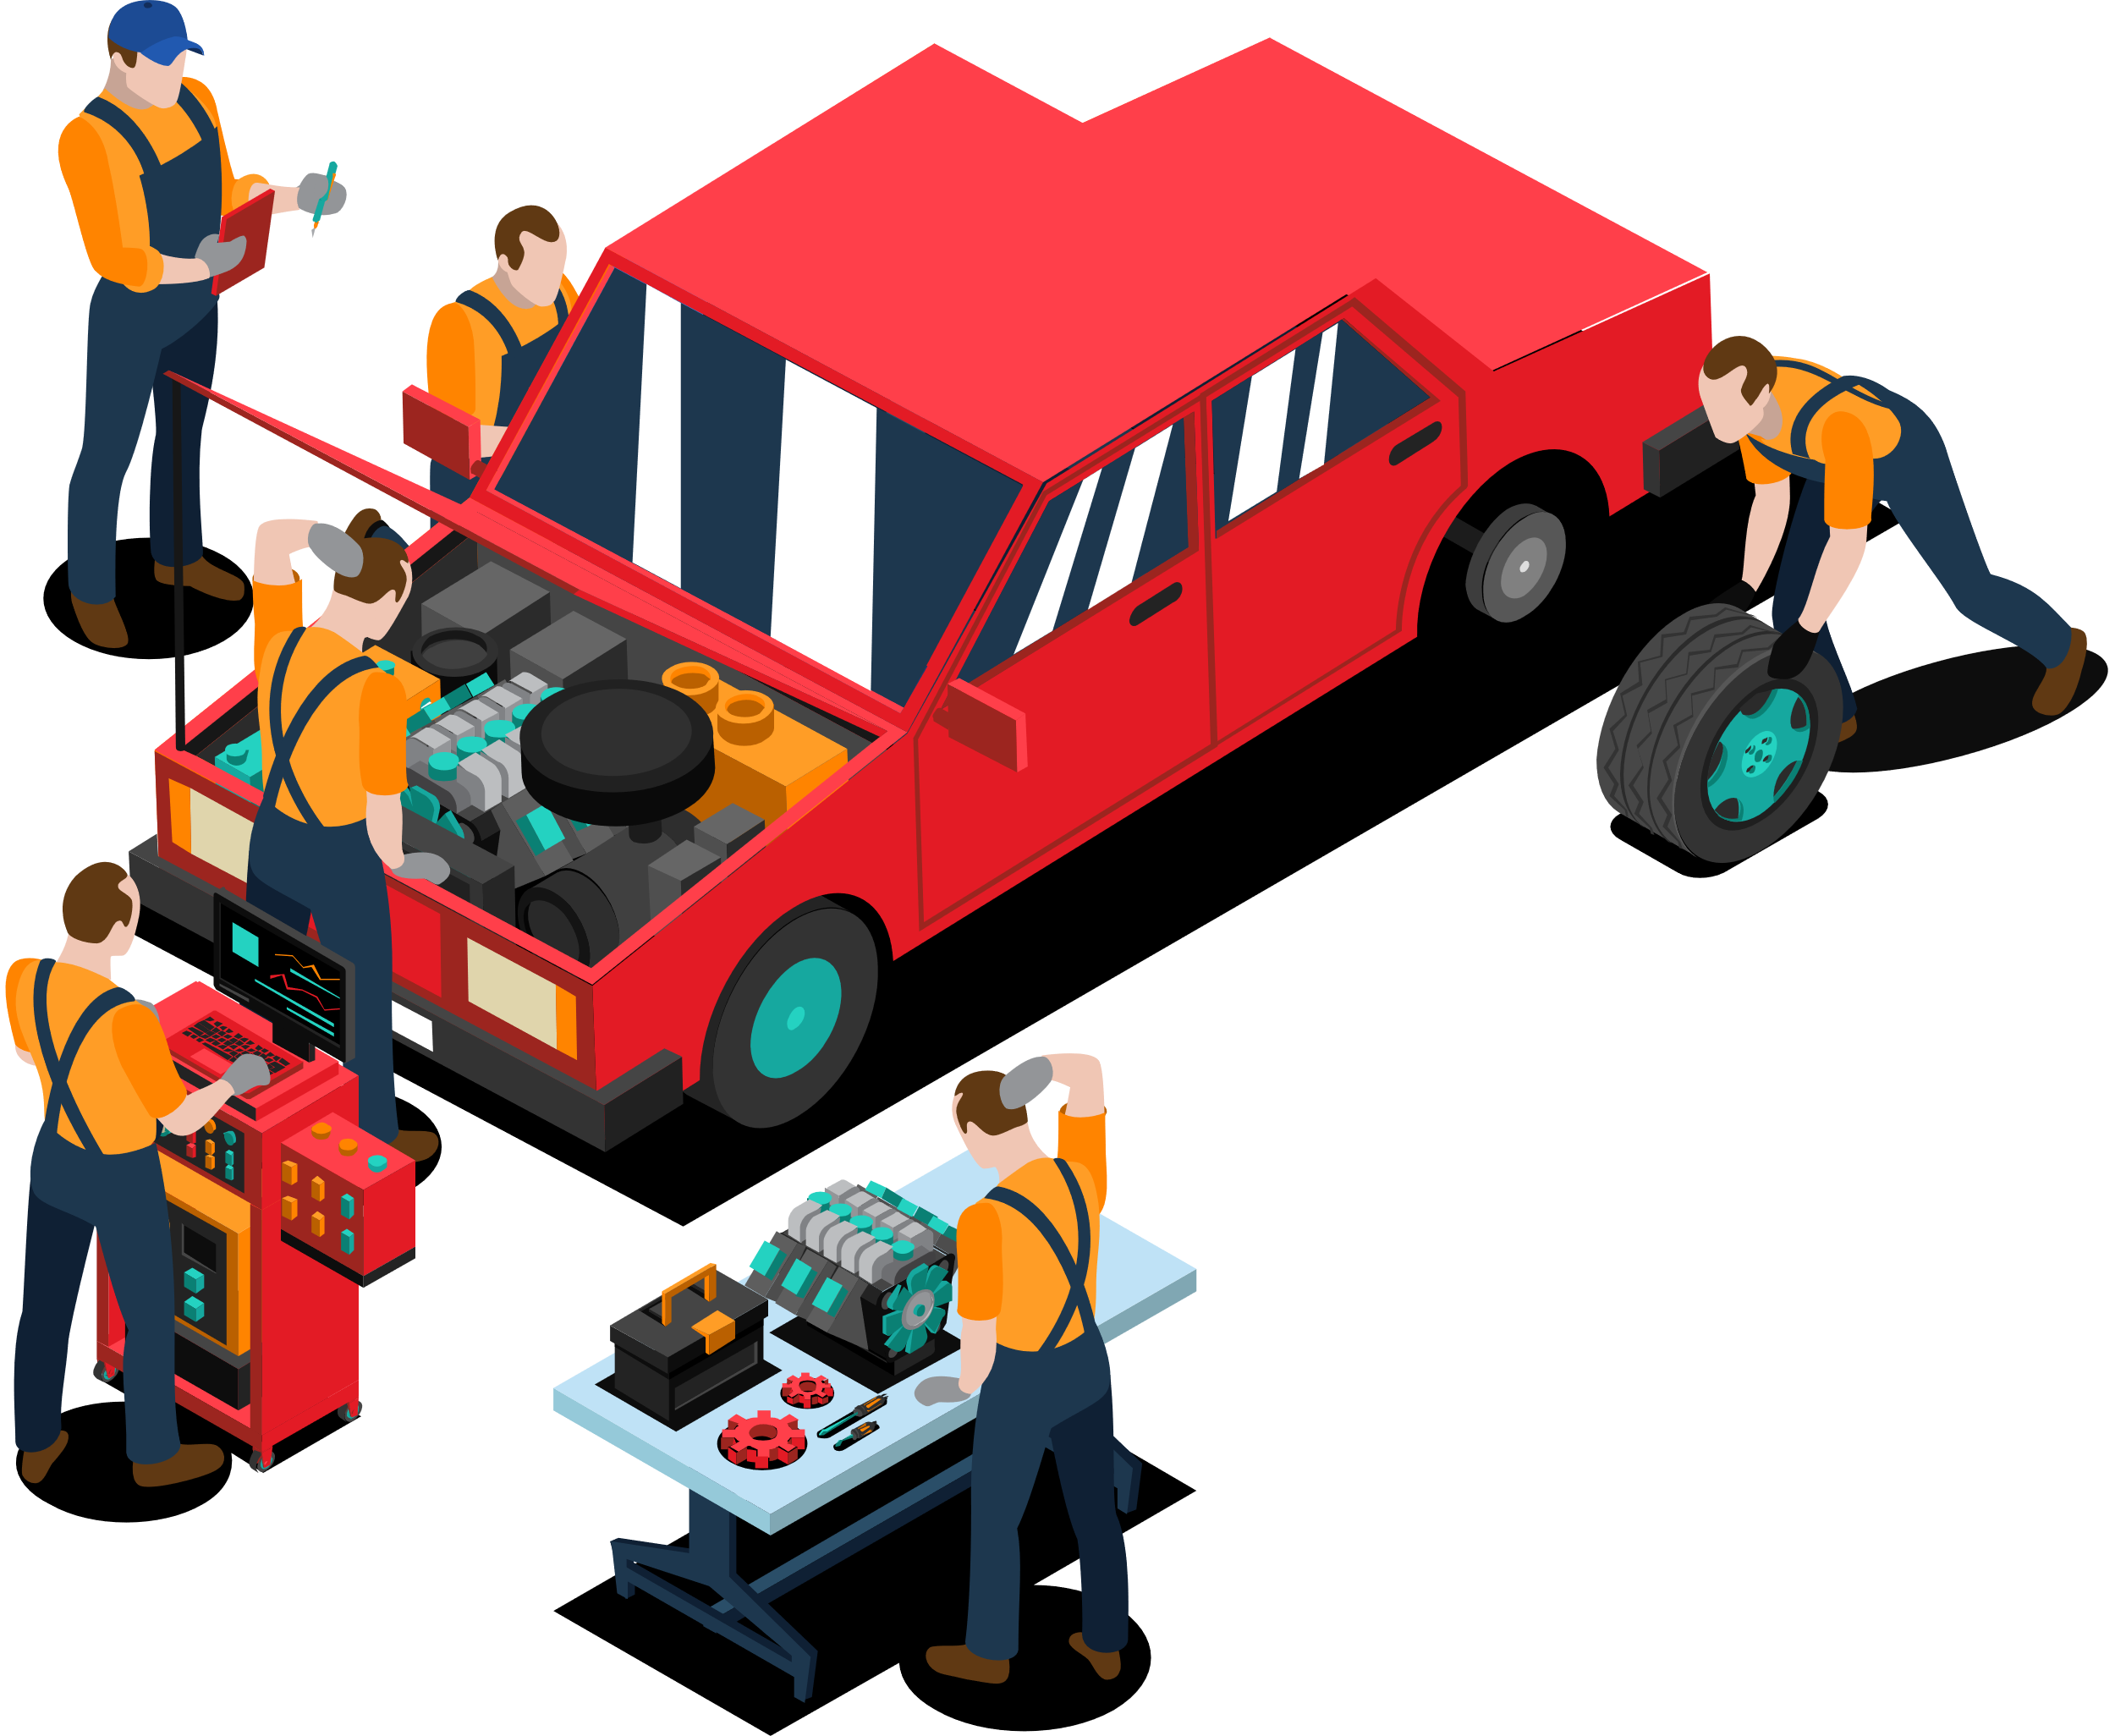

Smart Vehicle Inspection System

Slide 2

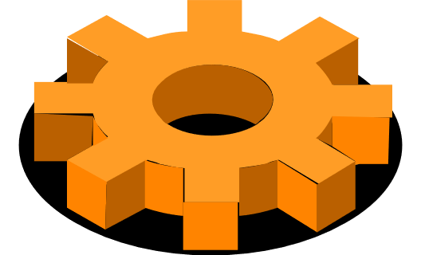

Submition And Supervision
FYP ADVISOR | Dr.Tahira Mahboob
CO-ADVISOR | Dr.Usman Younis
MEMBER-1 | Muhammad Furqan Omer
MEMBER-2 | Raja Ali Akhtar
MEMBER-3 | Muhammad Mughees Ul Haq

Slide 3


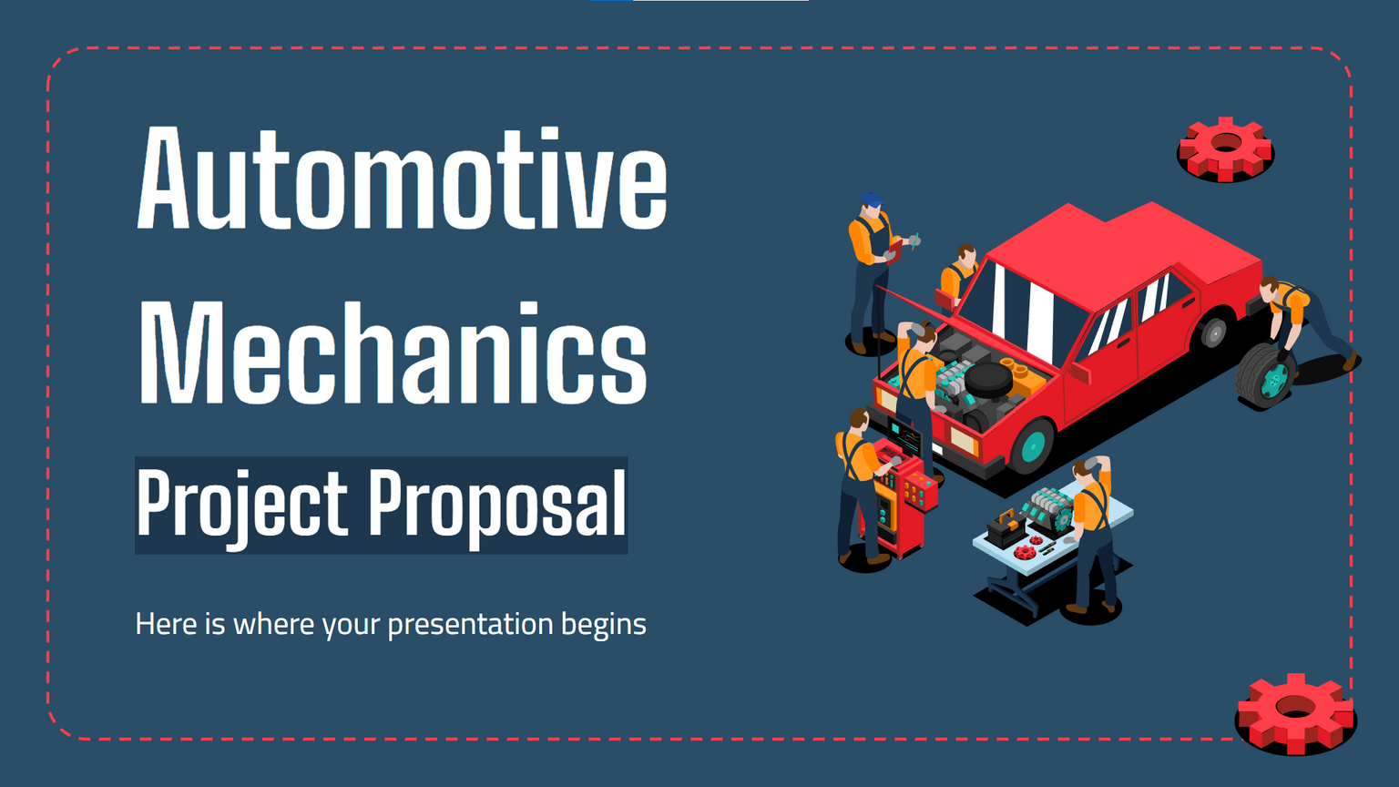

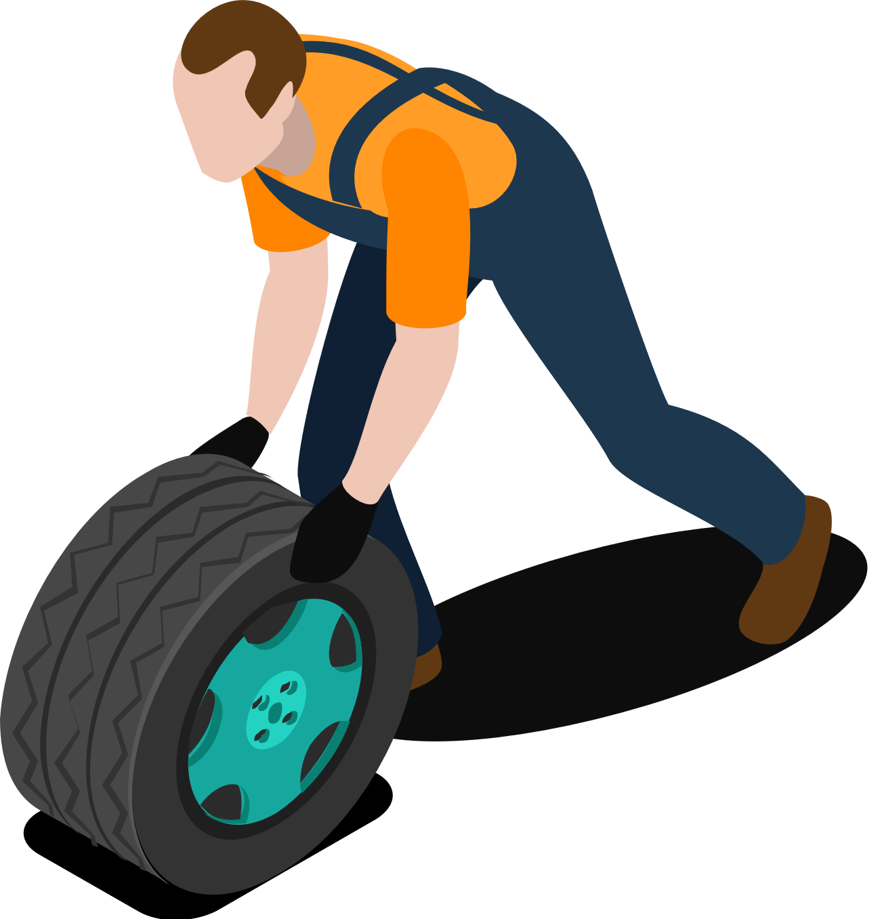
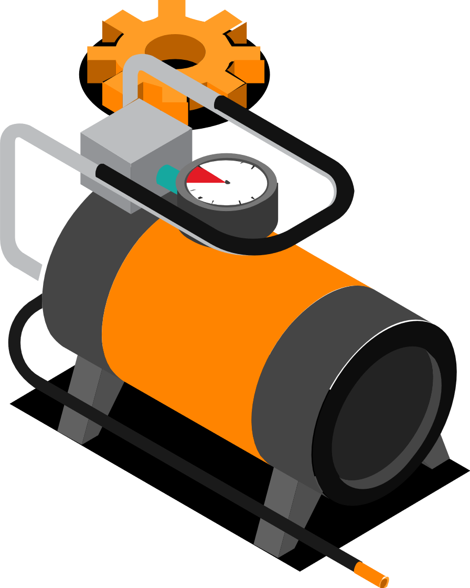
Background
Importance of Accurate Car Valuation: As demand for used cars grows, accurate assessments are crucial, yet current manual methods are prone to errors and subjectivity.
Challenges in Traditional Inspections: Surface damage detection and mechanical diagnostics are time-consuming and inconsistent, leading to disputes over vehicle condition and value.
Technological Advancements: Computer vision and OBD-II technology offer a chance to automate and improve the accuracy of vehicle inspections.
Need for Automation: An integrated system can reduce errors, save time, and provide reliable assessments for consumers, dealers, and insurers.

Slide 4

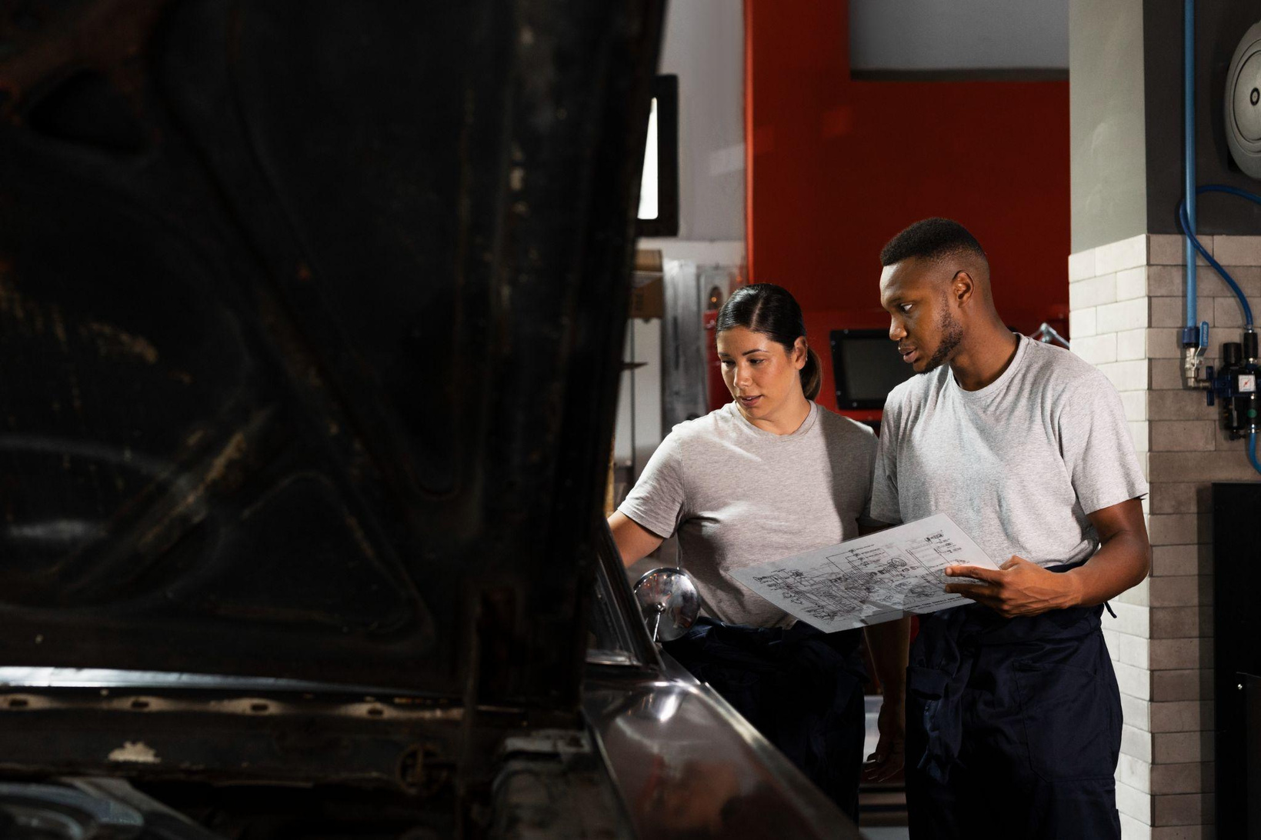

Problem Statement
The current inspection process relies heavily on subjective human judgment.
Errors and delays lead to disputes in car valuation.
There is a need for a comprehensive automated system that integrates:
Computer vision for visual damage detection
OBD-II diagnostics for mechanical health
Goal: To provide fast, reliable, and expert-level assessments through automation.

Slide 5

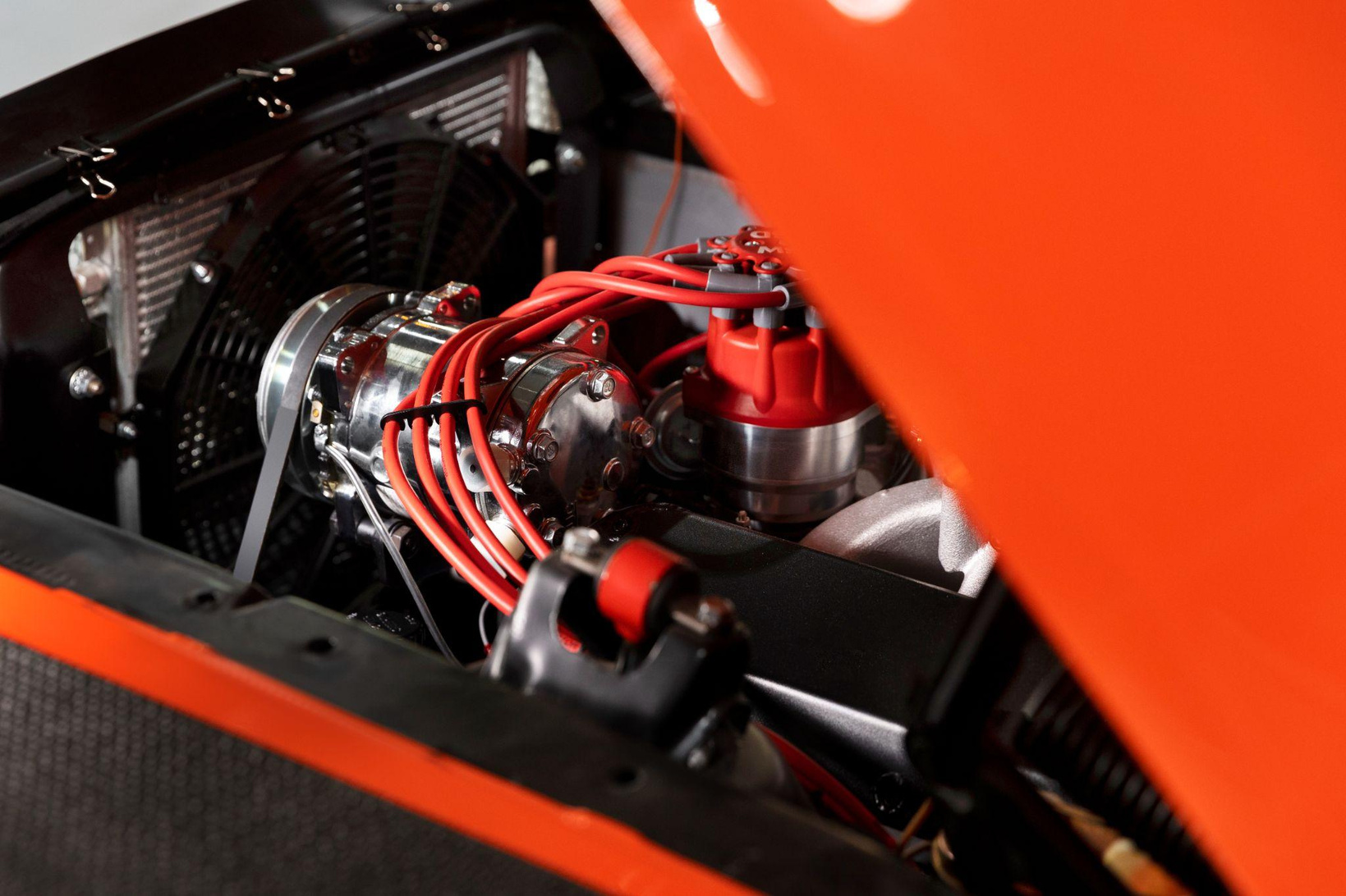
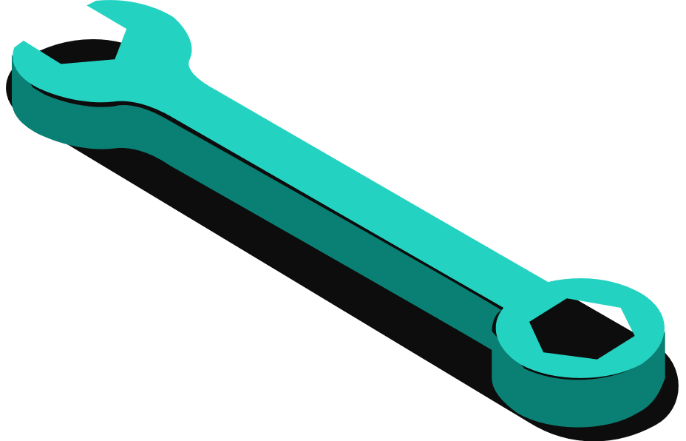


Sustainability: UN SDGs Alignment
Goal 9: Industry, Innovation, and Infrastructure
Automates vehicle inspections to improve efficiency and accuracy.
Goal 11: Sustainable Cities and Communities
Promotes safer and more sustainable transportation by encouraging timely vehicle repairs and maintenance.
Goal 12: Responsible Consumption and Production
Detects and addresses vehicle damage early, extending vehicle lifespan and reducing waste.

Slide 6
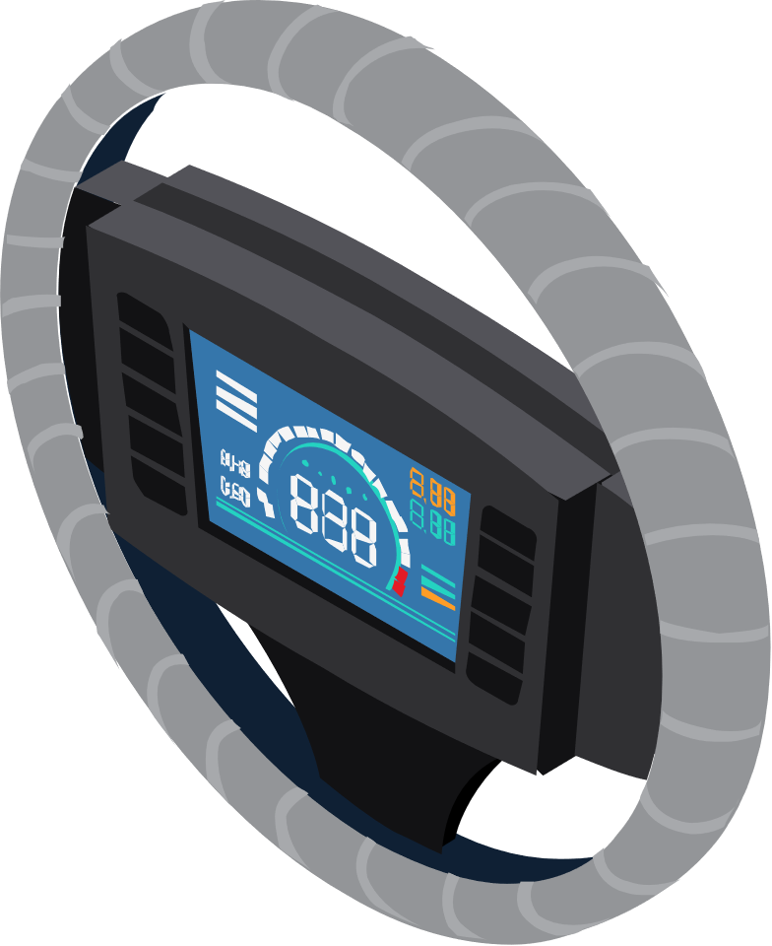
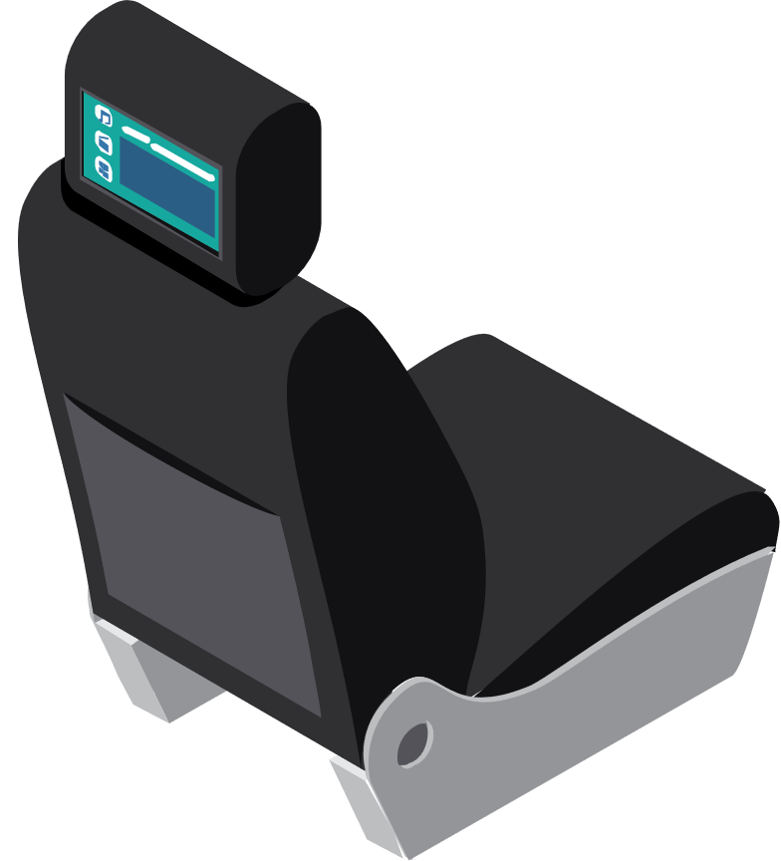
Objectives
Goal: Provide accurate, real-time vehicle inspections through automation
Objectives:
Detect and classify vehicle damage using computer vision models (YOLOv8)
Collect mechanical data via OBD-II for system diagnostics
Implement an interactive web application for inspection results and reports

Slide 7
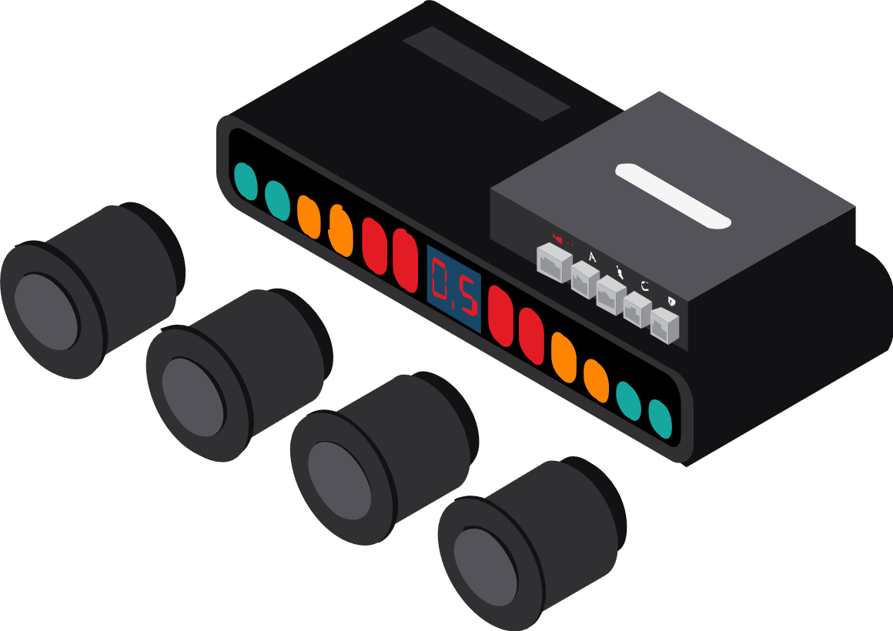

Literature Review & Analysis
Overview:
Automated vehicle inspection systems improve the objectivity of damage detection.
Techniques:
Convolutional Neural Networks (CNNs): Effective for recognizing damage patterns.
Mask R-CNN: A state-of-the-art architecture combining object detection and segmentation, offering precise damage localization.
OBD-II Data:
Provides real-time diagnostics for engine health, fuel efficiency, and performance monitoring.
Commonly used in fleet management for predictive maintenance.

Slide 8

Methodology Overview
Computer Vision Module:
Detect types and locations of damage using YOLOv8seg models.
Dataset: Annotated images of vehicle damages.
Damage-to-Part Mapping: Uses Intersection over Union (IoU) to link damage regions with car parts.
OBD-II Module:
Hardware: ESP32 microcontroller with ELM327 diagnostic tool
Parameters Queried: Battery voltage, engine RPM, coolant temperature, throttle position, etc.
Dynamic Protocol Switching: Ensures compatibility across various vehicle models

Slide 9
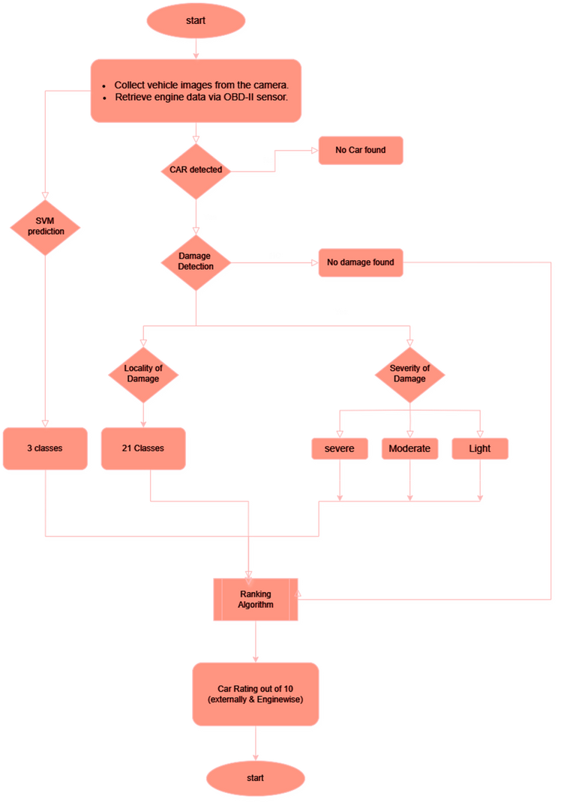
Flow Chart

Slide 10

System Architecture & Design
System Components:
Backend:
Django application handles API calls to models hosted on Roboflow.com.
Processes images and applies damage-to-part mapping logic.
Frontend:
Displays annotated results in real-time using HTML, CSS, and JavaScript.
Hardware Integration:
ESP32 communicates with OBD-II tools to fetch data from the car's ECU (Electronic Control Unit).

Slide 11

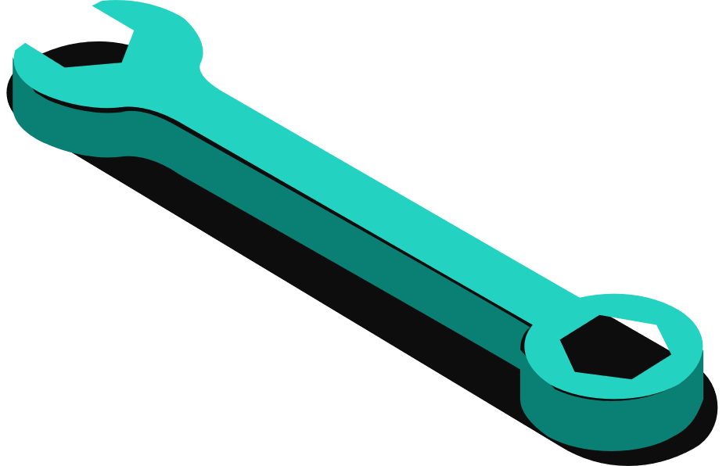


02
Progress On the OBD-II module

Slide 12

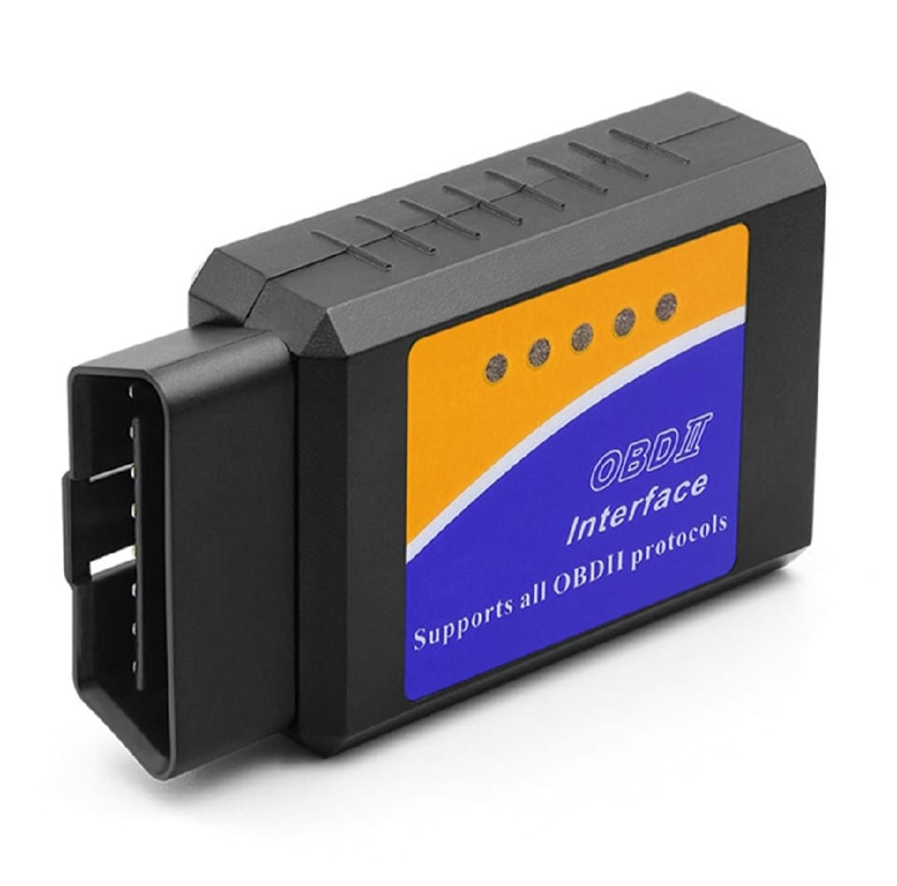

Objectives
Establish seamless communication between ESP32 microcontroller and ELM327 OBD-II diagnostic tool via WiFi.
Configure ESP32 to connect to ELM327's WiFi interface using IP: 192.168.0.10 and Port: 35000.
Implement error handling for WiFi connection attempts and client-side communication errors.
THE END GOAL
Query the Vehicle CAN BUS via the OBD-II to get the data from the ECU of the car for Future Use.

Slide 13
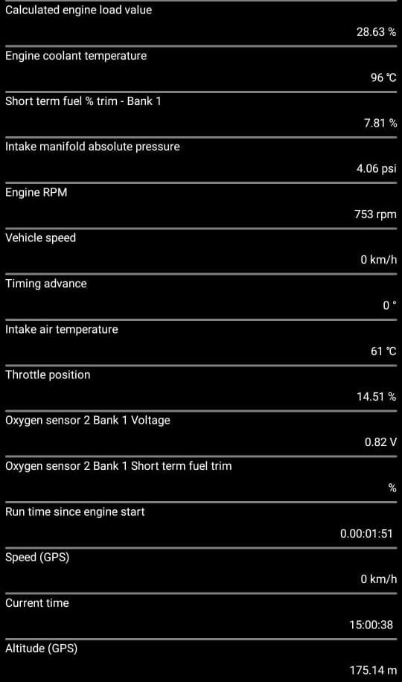
Implementing Data Query Functionalities
Key Vehicle Parameters Queried:
Battery Voltage
Engine RPM
Vehicle Speed
Fuel System Status
Engine Load
Coolant Temperature
Oil Temperature
Short and Long Term Fuel Trim
Distance Traveled with MIL On
Throttle Position and Relative Throttle Position

Slide 14
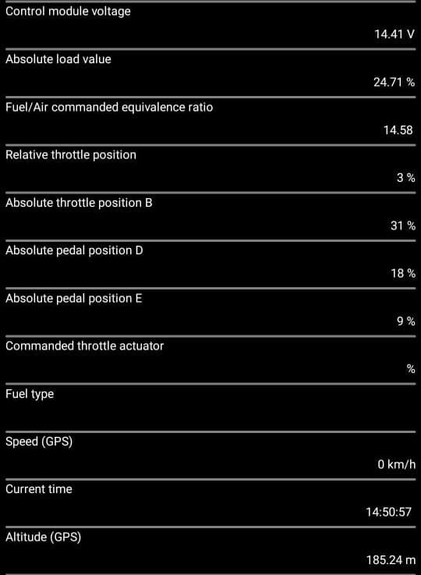
Handling Data Responses and Enhancing Code Modularity
Data Validation:
Each query function validates ELM327 responses, ensuring a successful state before processing data.
Utilize Serial.println() for debugging outputs to monitor system behavior.
Code Modularity:
Organize code into well-structured, independent functions for each parameter.
Facilitates easy debugging and scalability for future enhancements.

Slide 15
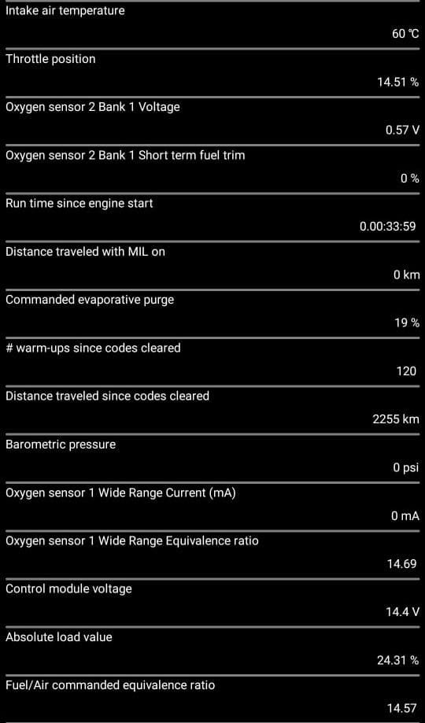
Challenges Encountered and Solutions Implemented
Challenge 1: Protocol Compatibility Issues
Issue: Some vehicles did not support certain OBD-II protocols, causing query failures.
Solution: Added a dynamic protocol detection mechanism to switch between supported protocols automatically during initialization.
Challenge 2: Debugging Data Responses
Issue: Misleading debugging outputs made it difficult to identify root causes during system failures.
Solution: Structured debugging outputs using consistent formats and categorized errors by type for easier troubleshooting.

Slide 16
01
Progress of the CV module

Slide 17

Objectives
The goal
Detect type and locality of damages on a car using computer vision.
Two independently trained models:
Damage Detection
Part Detection
Models integrated with a Django-based web application for real-time processing.

Slide 18


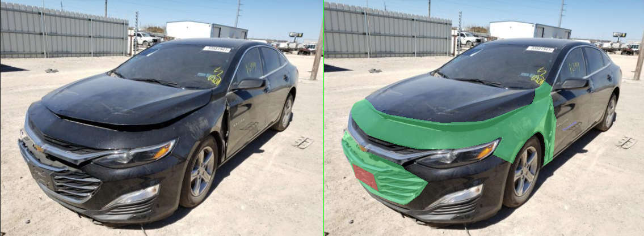
Dataset preparation:
Damage Detection
Simple image
Annotated image

Slide 19
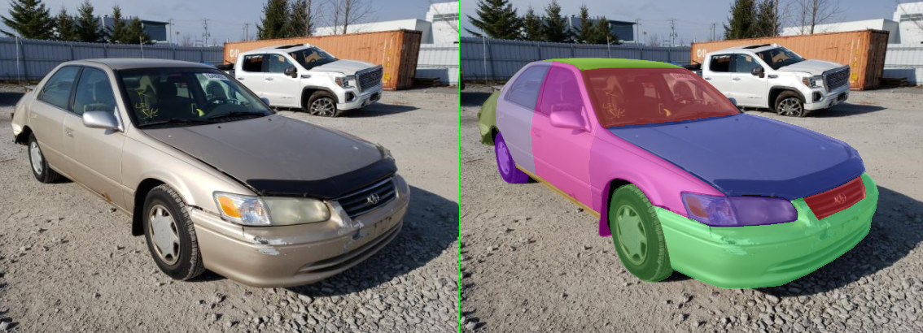
Dataset preparation:
Part Detection
Simple image
Annotated image

Slide 20
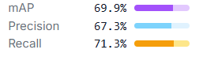
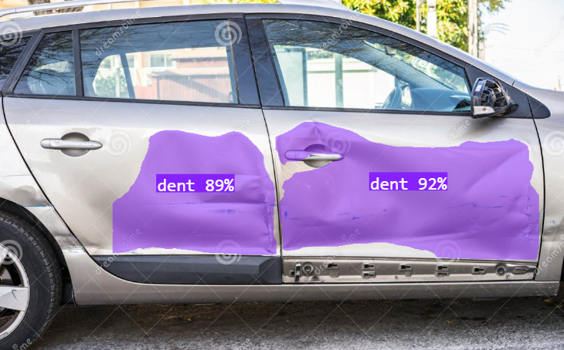
Damage Detection
MODEL : YOLOv8seg

Slide 21
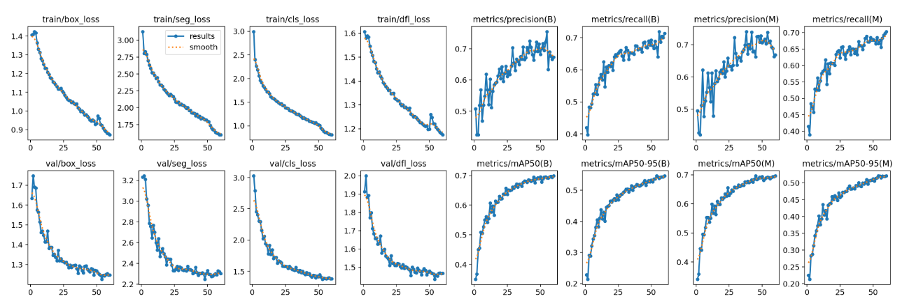
Training graphs
Simple image
Annotated image

Slide 22
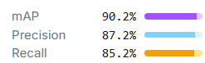
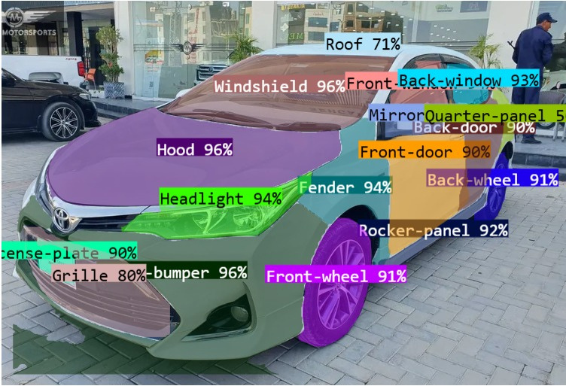
Part detection model
MODEL : YOLOv8seg

Slide 23
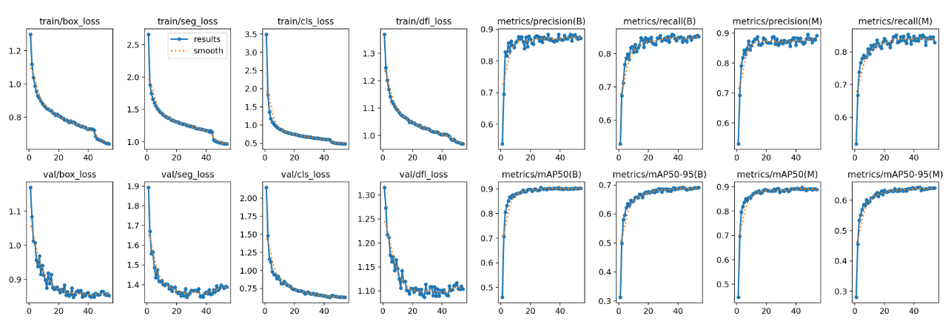
Training graphs
Simple image
Annotated image

Slide 24


Damage-to-Part Mapping Logic
Goal
Steps
Identify which part is damaged by calculating overlaps.
Extract bounding boxes from model outputs.
Calculate Intersection over Union (IoU) between damages and parts.
Assign damage to part if IoU > 0.5.
Example result:
“Scratch (0.85 confidence) detected on Front-Door (0.78 confidence).”

Slide 25
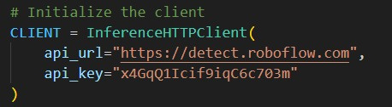
API Hosting and Integration
Platform: Hosted models on Roboflow.com.
API Endpoints:
Damage Detection API – Returns polygons, damage class, and confidence.
Part Detection API – Returns polygons, part class, and confidence.
Integrated APIs with Django to process images.

Slide 26
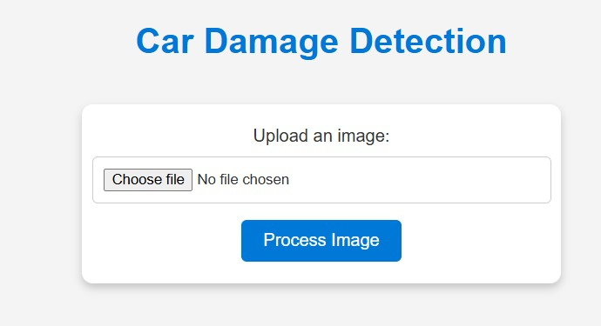
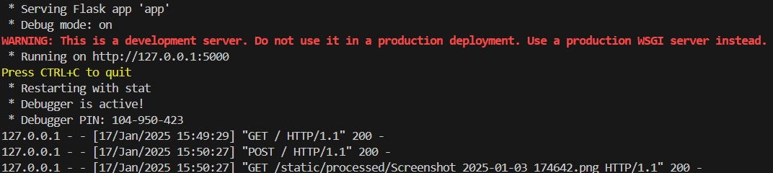
Django App
Backend:
Process uploaded images and call APIs.
Handle API responses and apply damage-to-part mapping logic.
Frontend:
Built with Django templates (HTML, CSS, JavaScript).
Displays processed results with annotations.
Real-time user interaction.

Slide 27
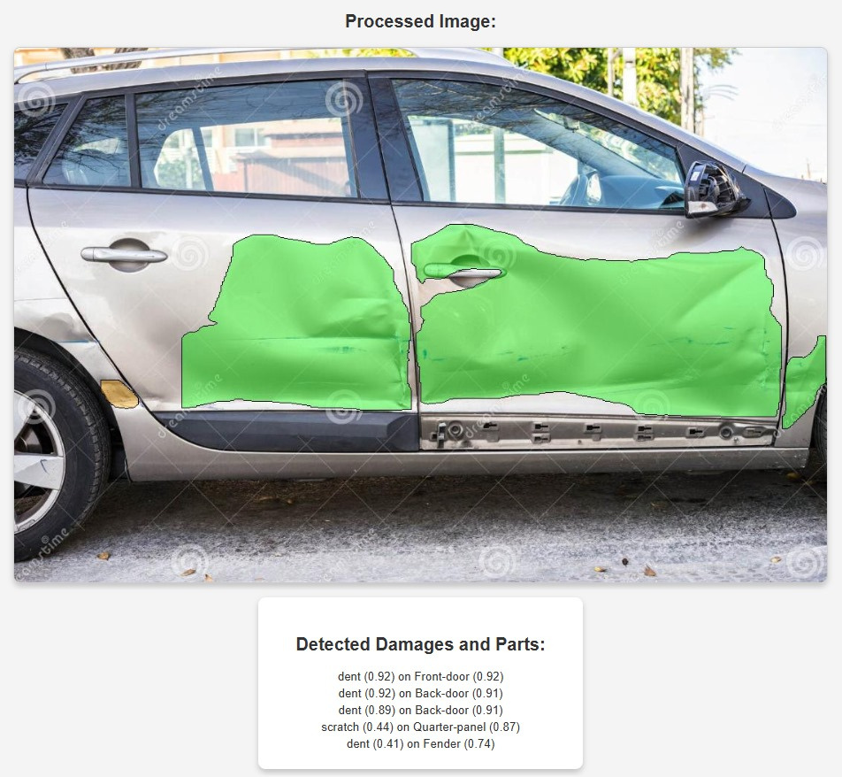
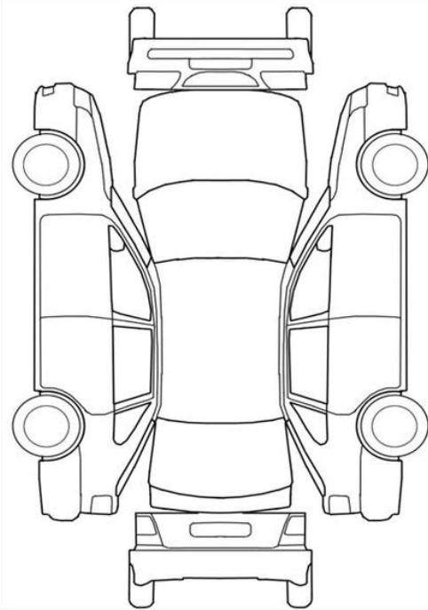
Output Visualization

Slide 28
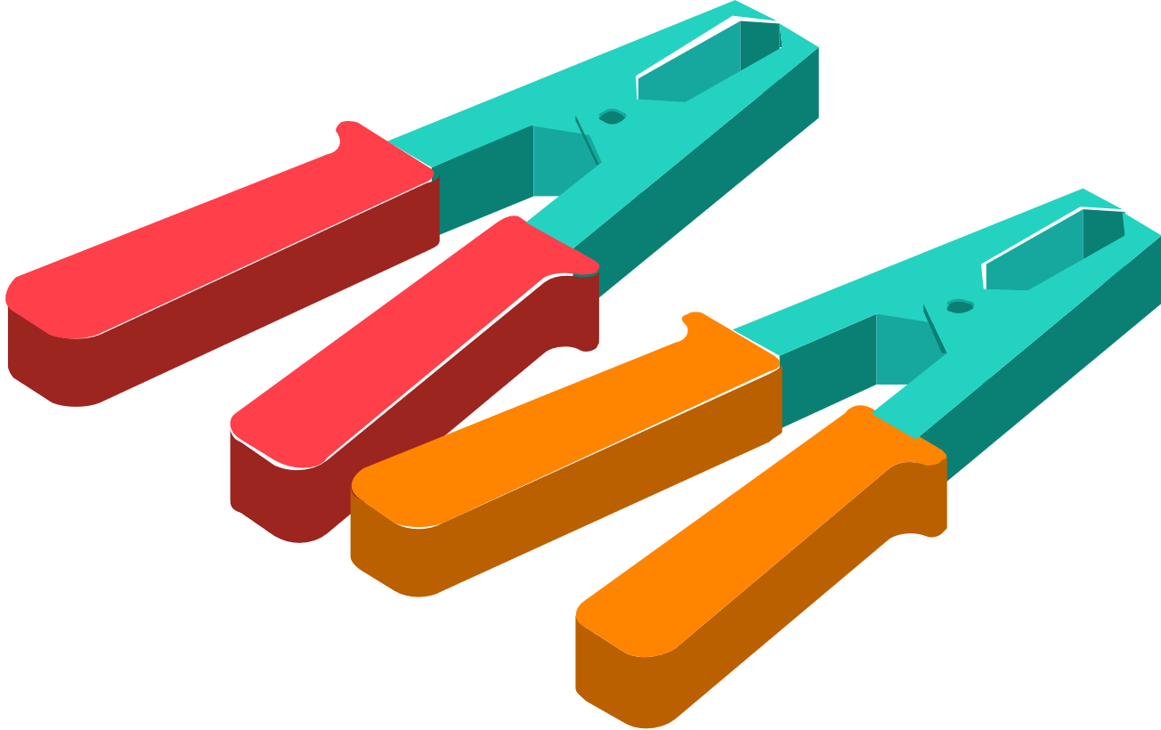



Project Timelines and Deliverables

Slide 29
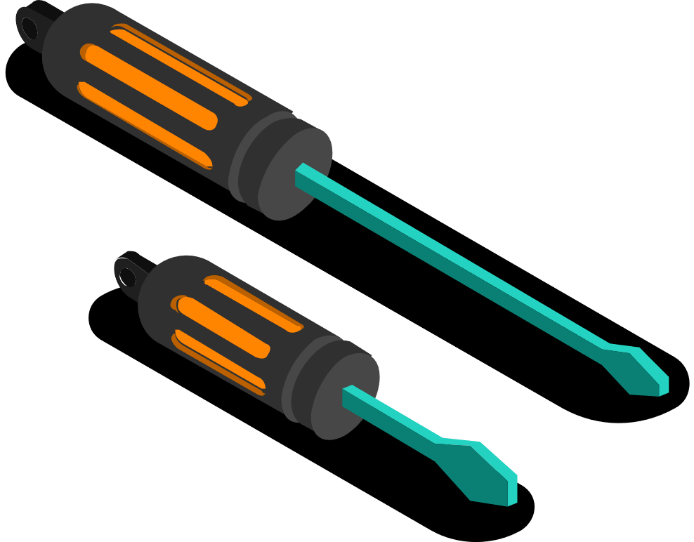
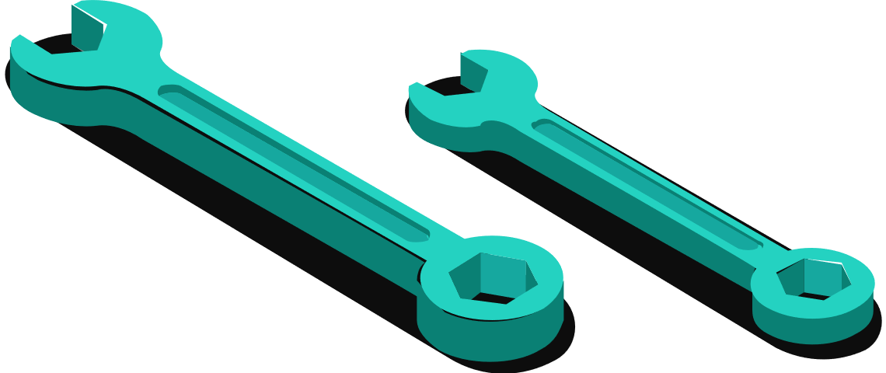
Project Timeline Overview
Start Date: September 16, 2024
End Date: May 20, 2025

Slide 30
Key Phases
Data Collection (Image & OBD-II):
October 21, 2024 - November 10, 2024
Model Setup and Damage Detection:
November 11, 2024 - January 19, 2025
Health Rating System & Final Integration:
January 20, 2025 - March 23, 2025
Testing & Refinement:
March 24, 2025 - May 20, 2025

Slide 31
Deliverables
Accurate vehicle health score based on visual and OBD-II data
Full vehicle health assessment system
Comprehensive project documentation and prototype

Slide 32
Stakeholder Analysis

Slide 33
Primary Stakeholders
Car Insurance Companies
Benefit: Accurate, automated vehicle assessments for faster claims processing.
Fleet Management Companies
Benefit: Real-time vehicle health monitoring for predictive maintenance.
Repair Shops
Benefit: Precise diagnostics, speeding up repair processes and improving service quality.
Individual Car Owners
Benefit: Early detection of vehicle issues leading to reduced repair costs and improved safety.
Government Authorities
Benefit: Streamlined roadworthiness inspections and regulatory compliance checks.

Slide 34
Risk Assessment

Slide 35
Risk Assessment and Mitigation Strategies
Risk 1: Data Integration Issues
Mitigation: Use modular software design to manage independent sensor inputs.
Backup Plan: Manual sensor calibration if synchronization fails.
Risk 2: Inaccurate Health Ratings
Mitigation: Perform iterative testing and refine models based on real-world data.
Backup Plan: Simplify algorithms for critical cases if performance goals are unmet.

Slide 36
Risk Assessment and Mitigation Strategies
Risk 3: Hardware Malfunctions
Mitigation: Include redundancy mechanisms and error-checking in software.
Backup Plan: Maintain backup hardware components.
Risk 4: Delays in Development
Mitigation: Build buffer time into the timeline and prioritize essential features.
Backup Plan: Focus on core system features like OBD-II data integration if delays occur.

Slide 37
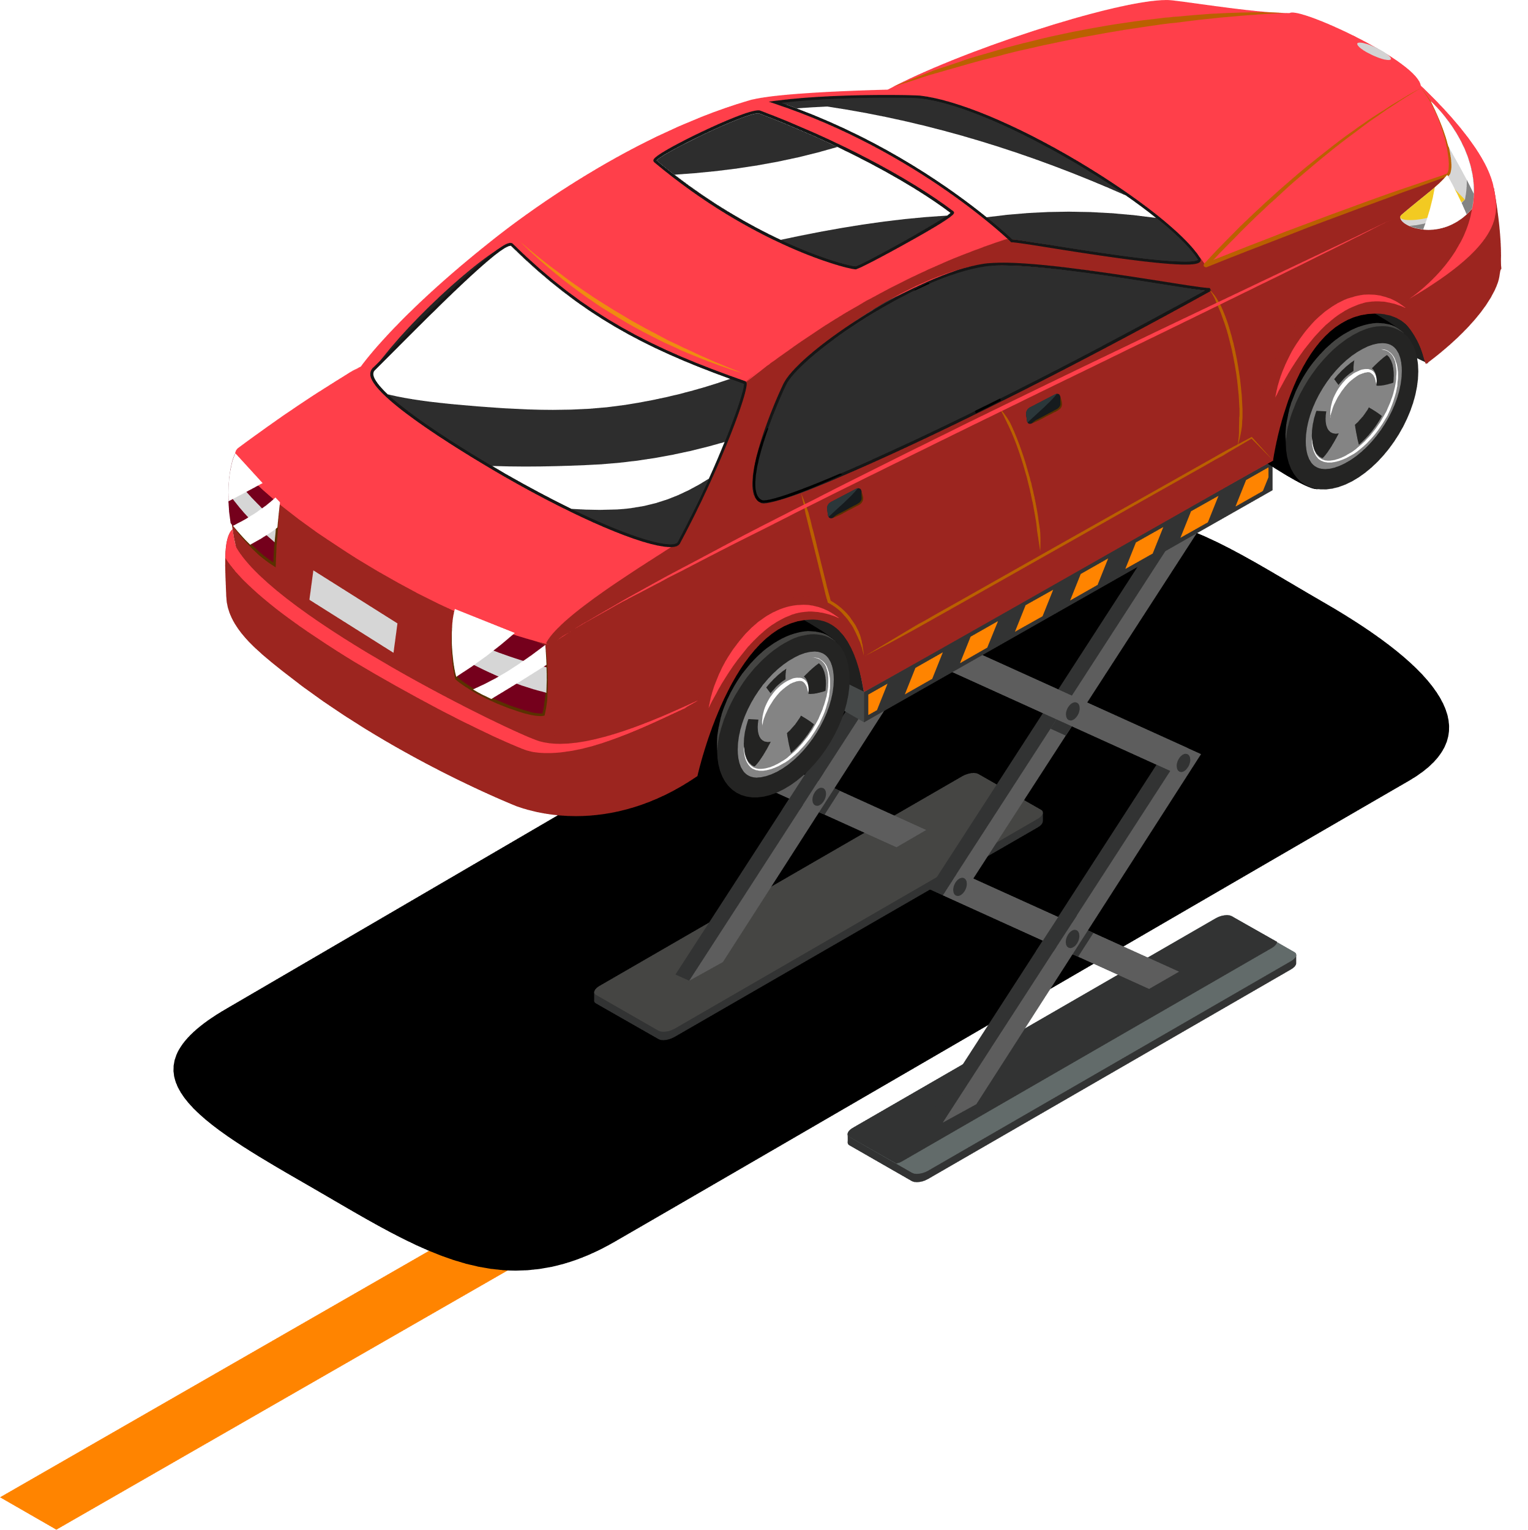




Thanks!
Do you have any questions?

Slide 38
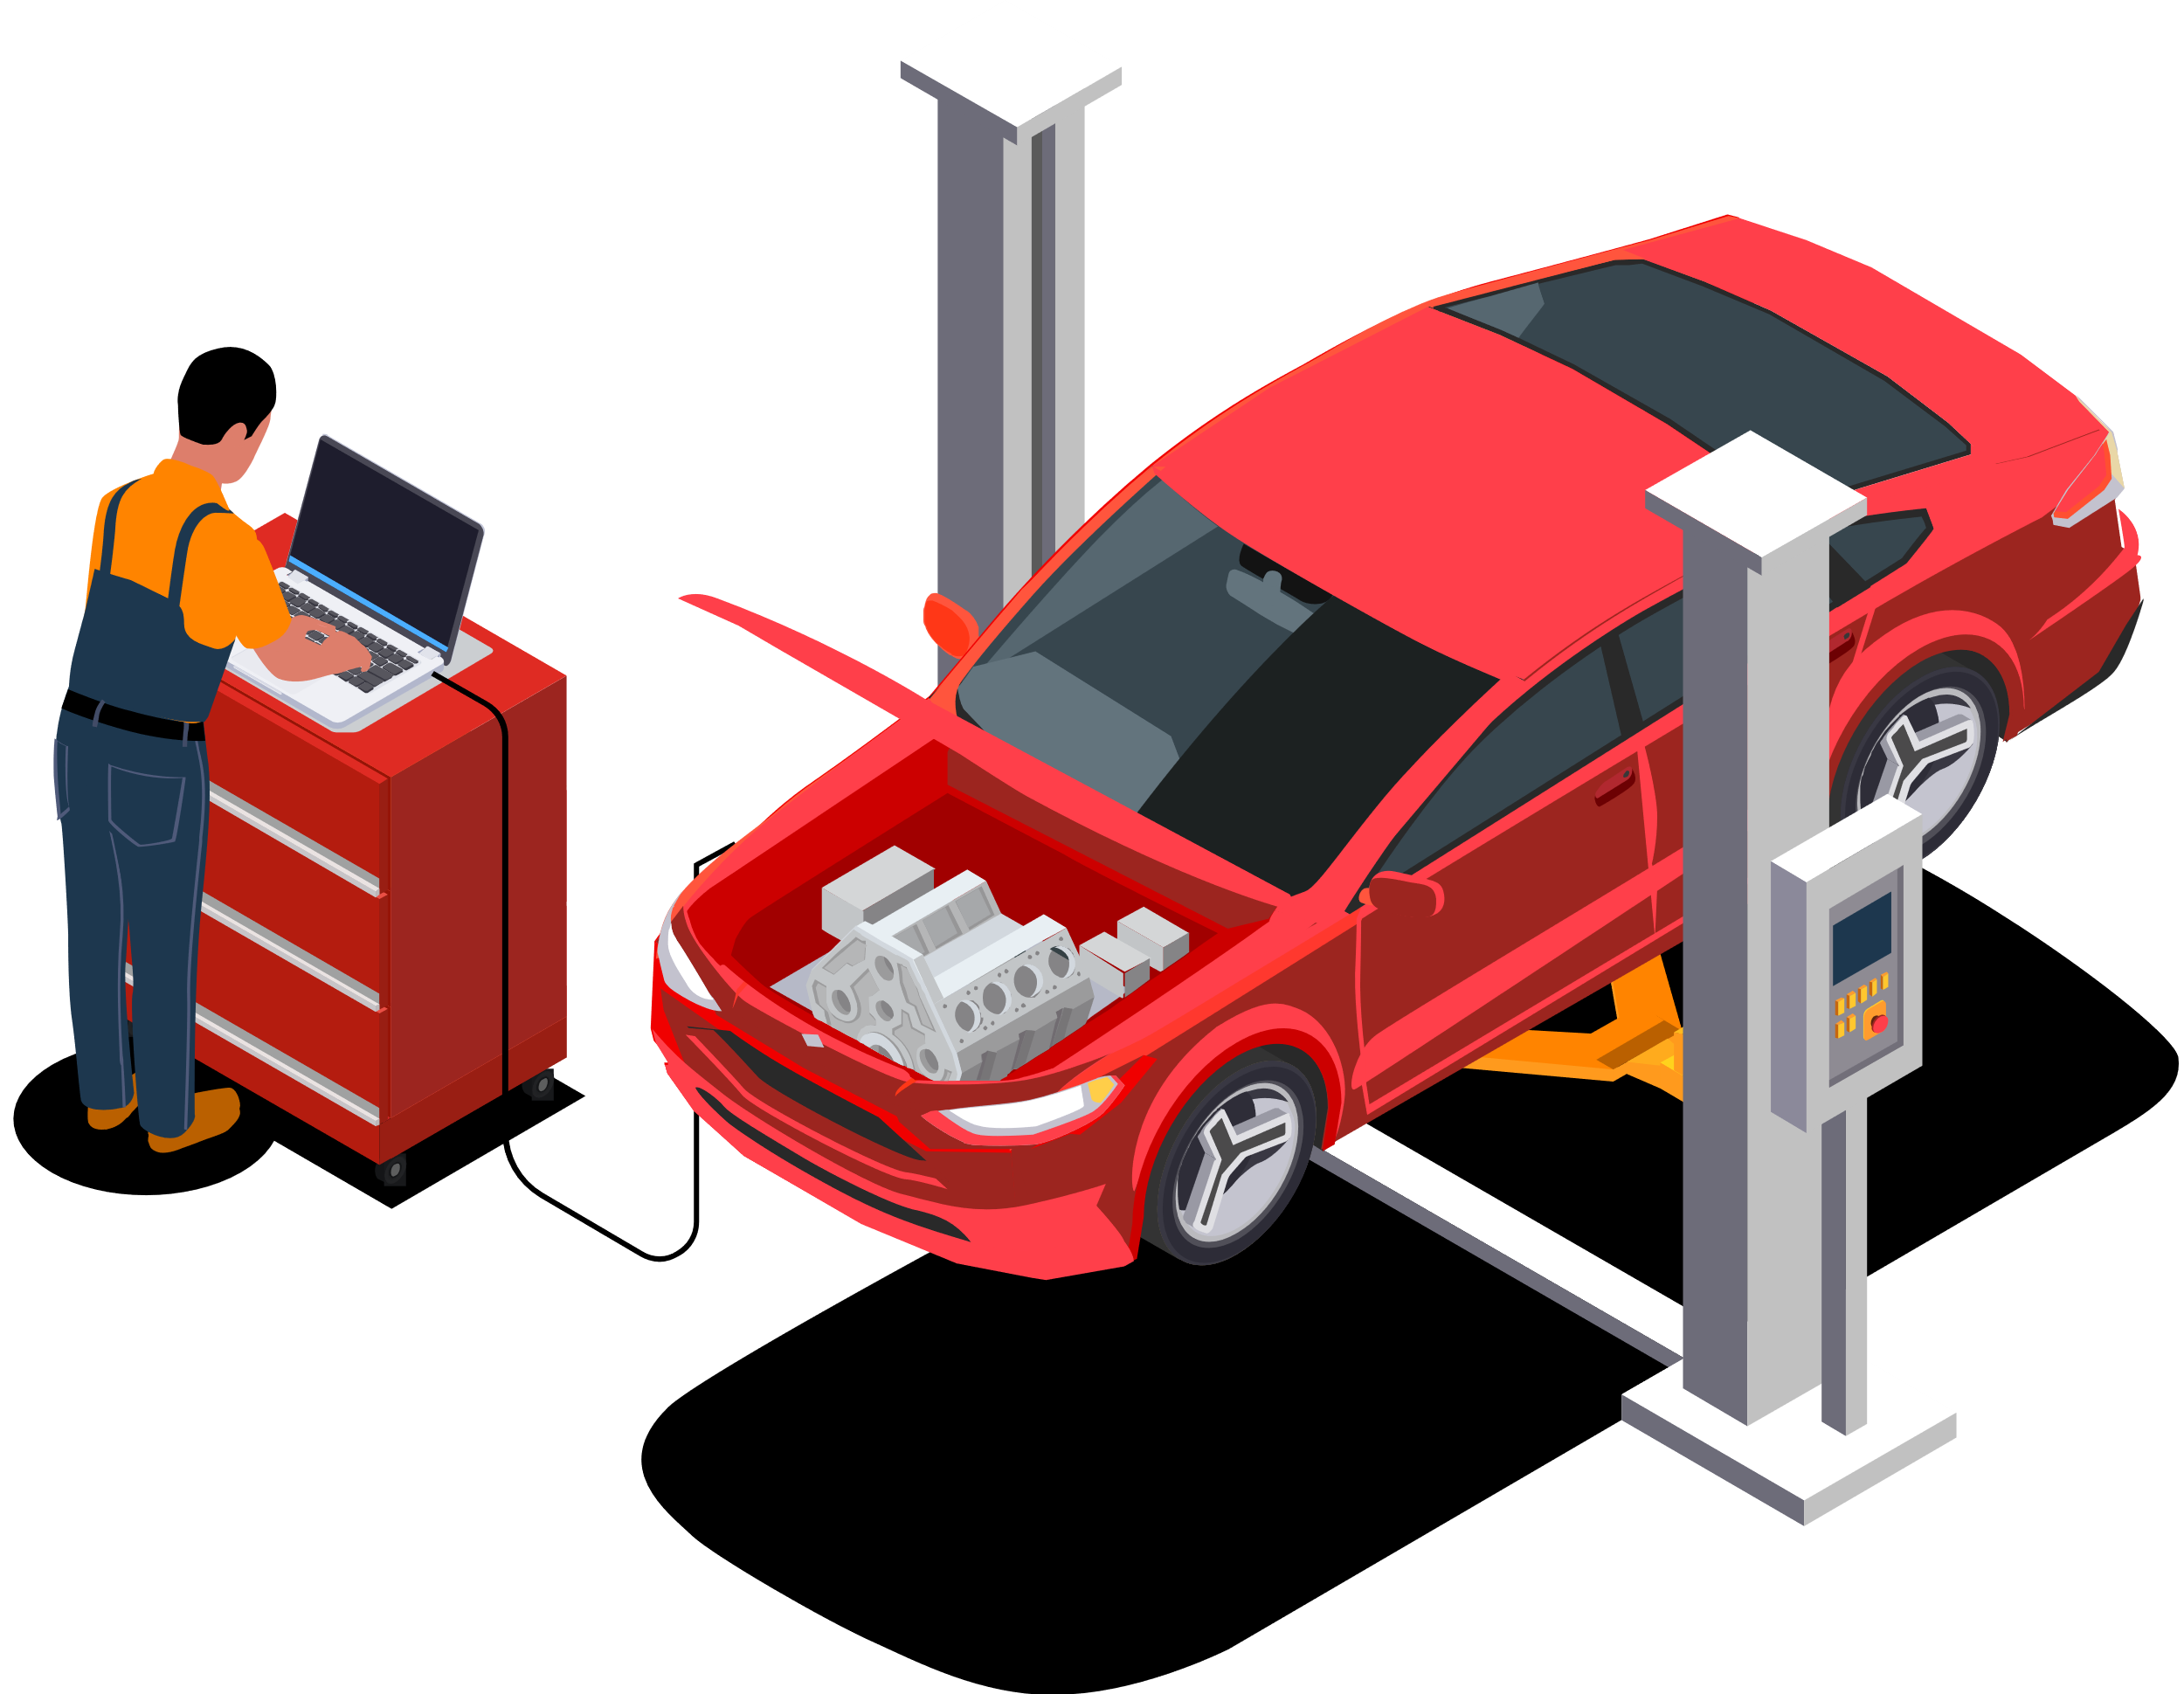
References
Automated Vehicle Damage Detection Using Deep Learning
R. C. Gonçalves et al., "Deep Learning for Vehicle Damage Detection: A Review," IEEE Access, 2021.
Link
Convolutional Neural Networks for Vehicle Damage Classification
D. D. Khare et al., "Vehicle Damage Detection Using Convolutional Neural Networks," International Journal of Engineering Research and Technology, 2020.
Link
Overview of OBD-II Protocol and Data Usage
R. H. Smith et al., "Understanding OBD-II: A Comprehensive Review," Journal of Transportation Technologies, 2019.
Link
Predictive Maintenance Using OBD-II Data
A. D. T. Oliveira et al., "Predictive Maintenance Based on OBD-II Data in Fleet Management," IEEE Transactions on Intelligent Transportation Systems, 2020.
Link
Machine Learning for Predictive Maintenance
T. Y. Choi et al., "A Survey on Machine Learning Applications for Predictive Maintenance," IEEE Access, 2020.
Link
Vehicle Health Monitoring with OBD-II
N. A. B. Sulaiman et al., "Vehicle Health Monitoring Using OBD-II Data," Journal of Vehicle Design, 2018.
Link
Integration of Computer Vision and OBD-II for Automotive Applications
Y. D. Li et al., "Integration of Computer Vision and OBD-II for Comprehensive Vehicle Diagnostics," IEEE Transactions on Automation Science and Engineering, 2022.
Link

